Slide 1
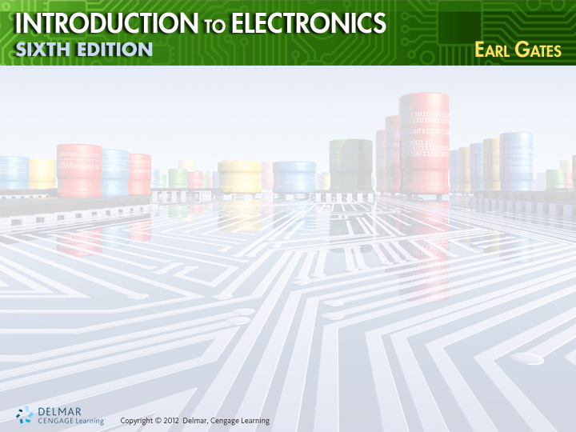
Chapter 27
Power Supplies

Slide 2
Objectives
After completing this chapter, you will be able to:
  Explain the purpose of a power supply
  Draw a block diagram of the circuits and parts of a power supply
  Describe the three different rectifier configurations
  Explain the function of a filter

Slide 3
Objectives (cont’d.)
  Describe the two basic types of voltage regulators and how they operate
  Explain the function of a voltage multiplier
  Identify over-voltage and over-current protection devices

Slide 4
Transformers
Transformers
  Used in power supplies for isolation
  Used to step up or step down the voltage
Primary power ratings
  110 to 120 volts
  220 to 240 volts

Slide 5
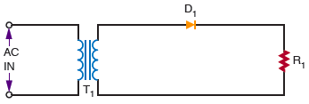
Rectifier Circuits
Figure 27-1. Basic half-wave rectifier.

Slide 6
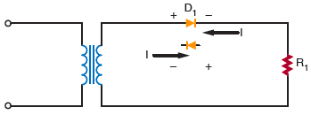
Rectifier Circuits (cont’d.)
Figure 27-4. The diode determines the direction of current flow.

Slide 7
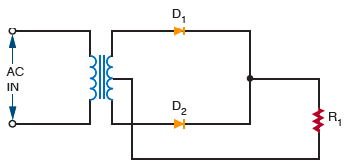
Rectifier Circuits (cont’d.)
Figure 27-5. Basic full-wave rectifier circuit.

Slide 8
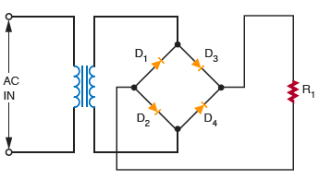
Rectifier Circuits (cont’d.)
Figure 27-8. Bridge rectifier circuit.

Slide 9
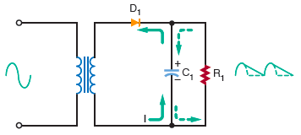
Filter Circuits
Figure 27-11. Half-wave rectifier with capacitor filter.

Slide 10
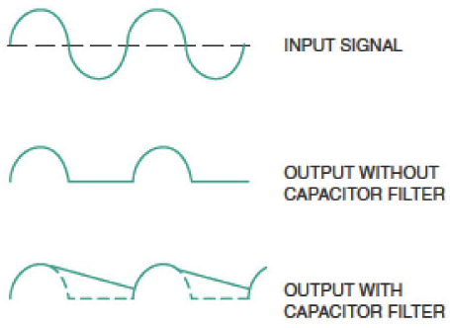
Filter Circuits (cont’d.)
Figure 27-12. Output of a half-wave rectifier
without and with a filter capacitor.

Slide 11
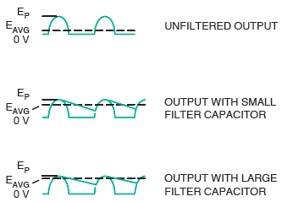
Filter Circuits (cont’d.)
Figure 27-13. Effects of different filter capacitors on output of half-wave rectifier.

Slide 12

Voltage Regulators
Figure 27-17. Basic zener diode regulator circuit.

Slide 13
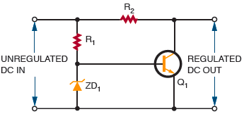
Voltage Regulators (cont’d.)
Figure 27-18. Shunt regulator using a transistor.

Slide 14
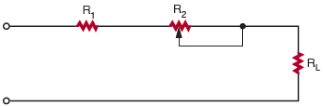
Voltage Regulators (cont’d.)
Figure 27-19. Series regulator using a variable resistor.

Slide 15
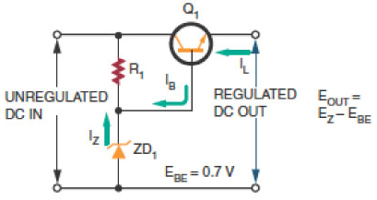
Voltage Regulators (cont’d.)
Figure 27-22. A series regulator.

Slide 16
Voltage Multipliers
Voltage multipliers
  Provide higher DC voltage than the input without the aid of a transformer
Voltage doubler
Voltage tripler

Slide 17
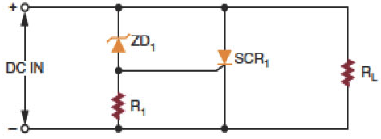
Circuit Protection Devices
Figure 27-37. Crowbar overprotection circuit.

Slide 18
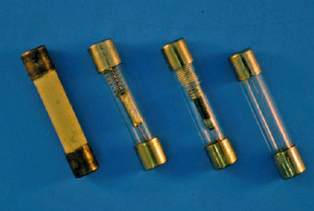
Circuit Protection Devices
(cont’d.)
Figure 27-38. Fuses used for protection of electronic circuits.

Slide 19
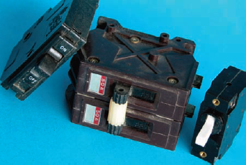
Circuit Protection Devices
(cont’d.)
Figure 27-39. Circuit breakers used for protection of electronic circuits.

Slide 20
Summary
The primary purpose of a power supply is to convert AC to DC
The basic rectifier circuits are half-wave, full-wave, and bridge
To convert pulsating DC voltage to a smooth DC voltage, a filter must follow the rectifier in the circuit

Slide 21
Summary (cont’d.)
The two basic types of regulator are the shunt regulator and the series regulator
Voltage multipliers are circuits capable of providing higher DC voltages than the input without the aid of a transformer
A crowbar is a circuit designed for over- voltage protection
A fuse protects a circuit from a current

